Slide 1
The role of metal-oxide grain boundaries for applications in photovoltaics and spintronics
Keith McKenna
Department of Physics, University of York
Notes:
40 + 5

Slide 2
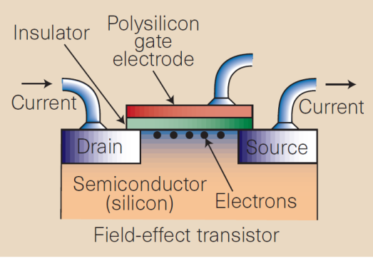
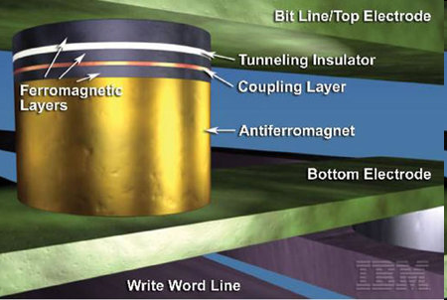

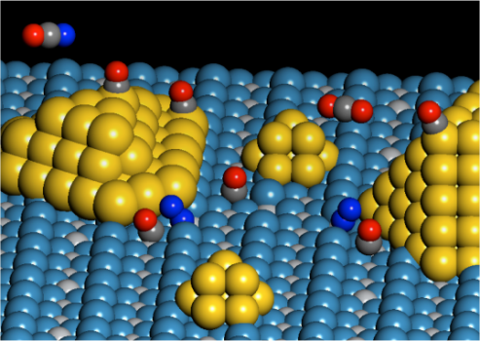
McKenna Materials Modelling group
Structure and properties of nanostructured materials underpinning applications in areas such as electronics, energy and catalysis
Semiconductor electronics
Spintronics
Claudio Padilha (PDRA)
Jonathan Bean (PhD)
Steven Hung (PhD)
Solar cells
Catalysis
John Carey (PDRA)
Razak Elmaslmane (PhD)
James Quirk (PhD)
Adam Kerrigan (PhD)
Steven Hung (PhD)

Slide 3

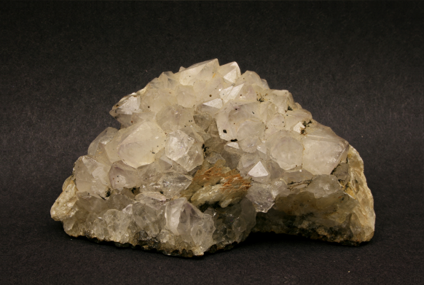
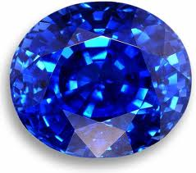
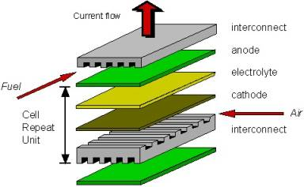
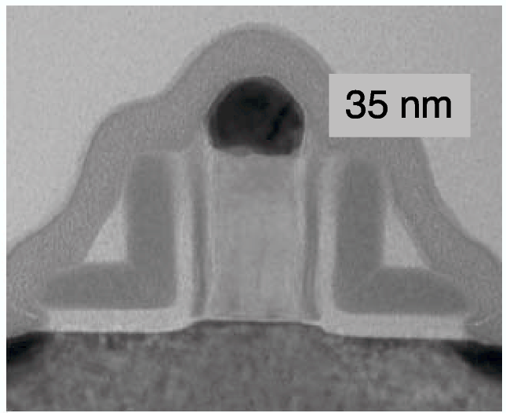

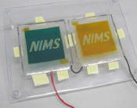
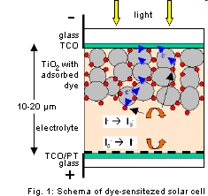

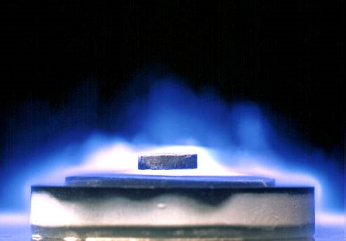
Introduction
Metal-oxides ubiquitous in nature and applications

Slide 4
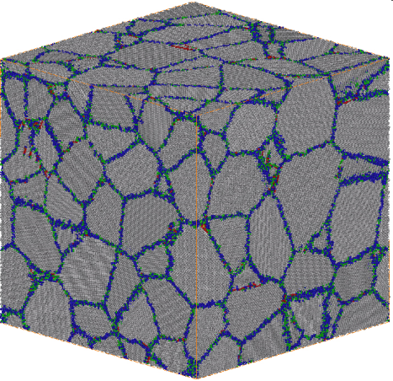
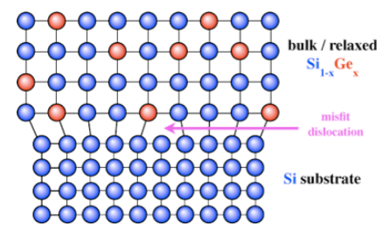
Extended defects in oxides
Most oxides are polycrystalline → grain boundaries
Oxide films often contain dislocations (lattice mismatch, non-equilibrium growth)
Modified structure and defect segregation affects many properties
Also affects electronic properties
high-T_{c} superconductors, solar cells, electroceramics, ferroelectrics, magnetic oxides, conducting oxides, microwave dielectrics, photo-catalysts…
Not well understood as difficult to probe electronic properties of buried extended defects directly
Grain boundary
Misfit edge dislocation
A. P. Sutton and R. W. Balluffi, Interfaces in Crystalline Materials (Oxford University Press, 1995)

Slide 5
Outline
Methods
Grain boundary controlled electron mobility in TiO₂
Antiphase boundary defects in Fe₃O₄
Grain boundaries in magnetoresistive tunnel junctions

Slide 6
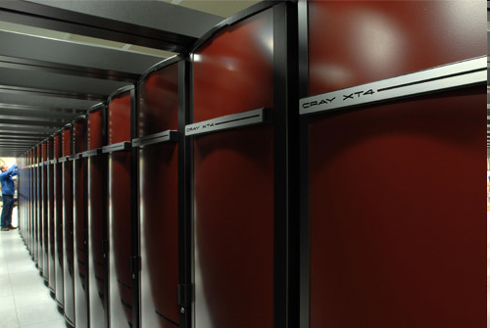
Methods

Slide 7
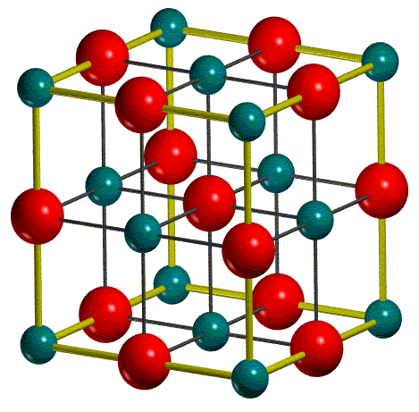
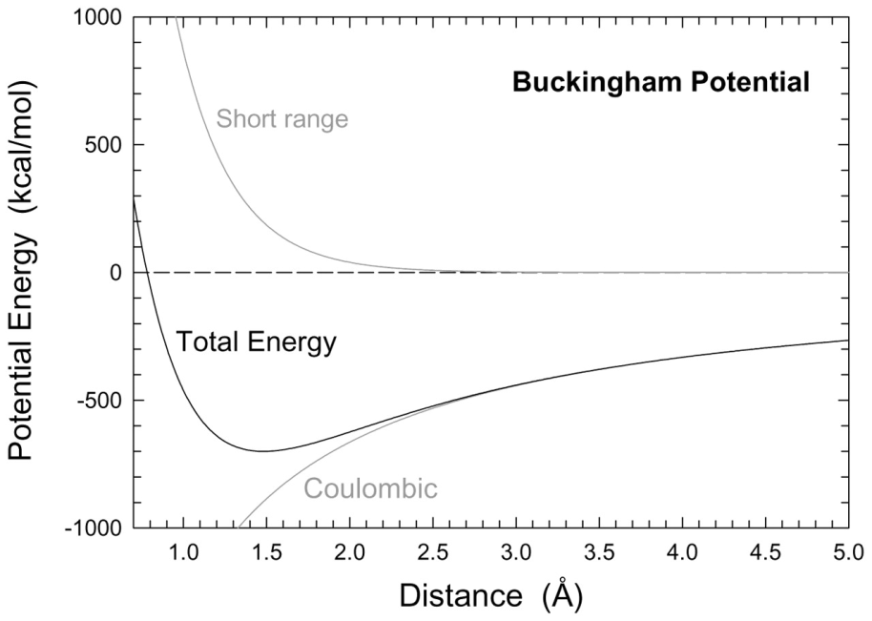
Atomistic interatomic potentials
For ionic materials shell model potentials are very accurate and efficient
Electrostatic + short range + polarisability
Parameterised against experimental properties
Low computational cost → large complex systems and efficient screening
Mg²⁺
O²⁻
Y
G. V. Lewis and C. R. A. Catlow, J. Phys. C 18, 1149 (1985)

Slide 8
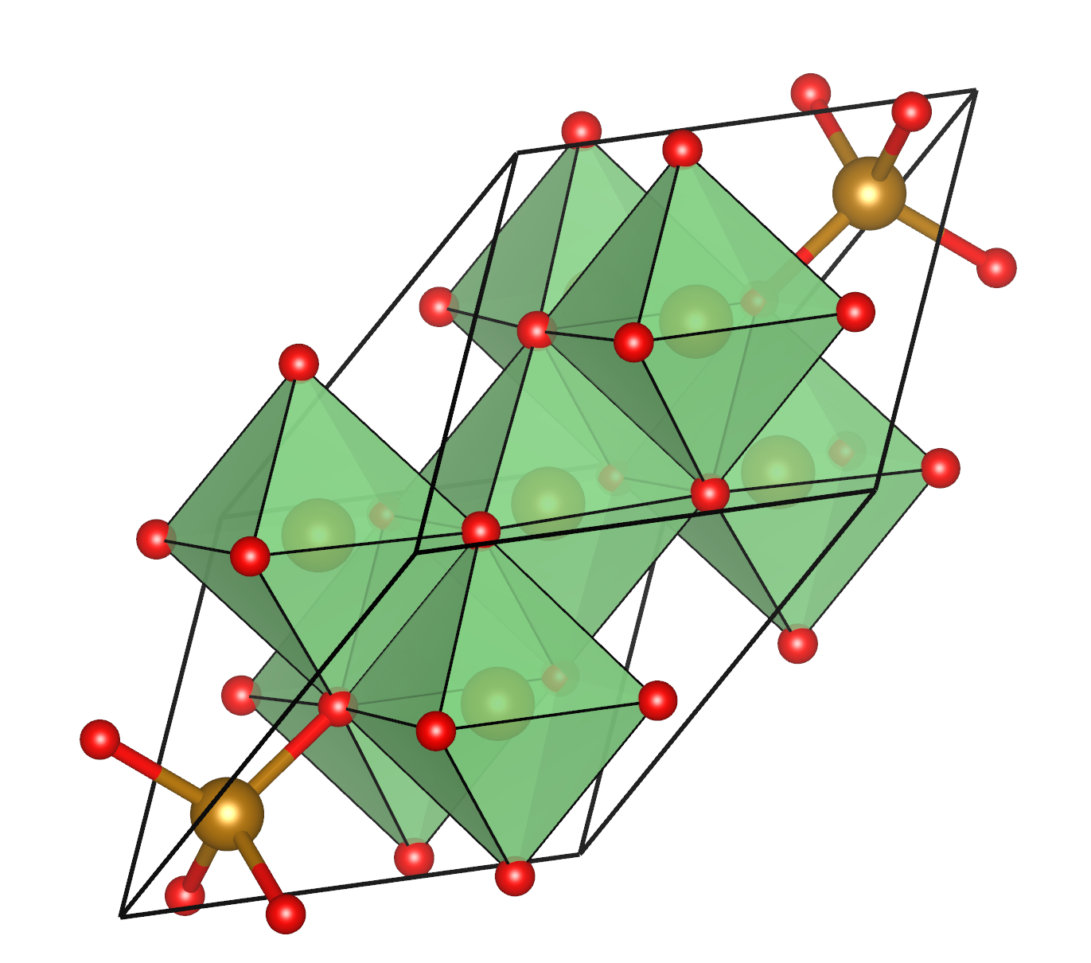
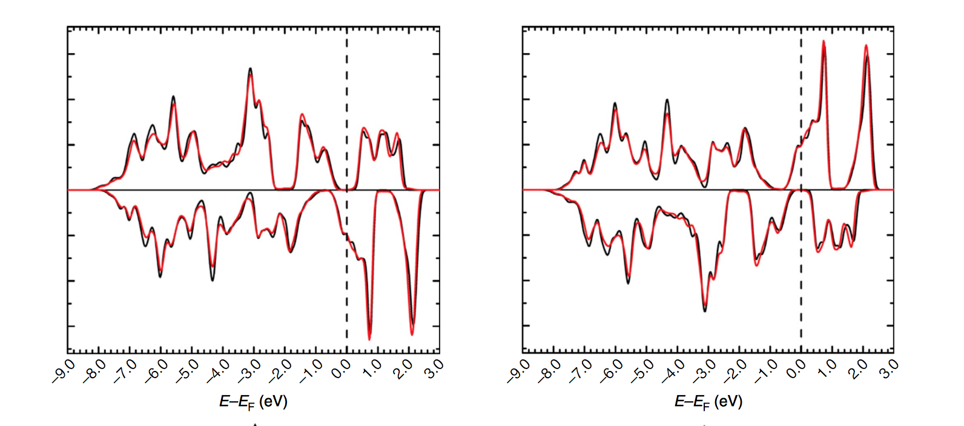
First principles theoretical modelling
Solve many-electron problem to determine most stable structure
Density functional theory good compromise between accuracy and computational cost
Predict structure of materials in 3D (dependence on conditions)
Predict corresponding properties (including those that are difficult to measure directly)

Slide 9
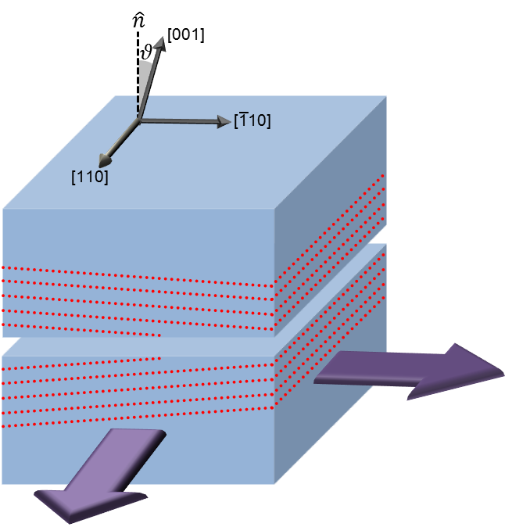
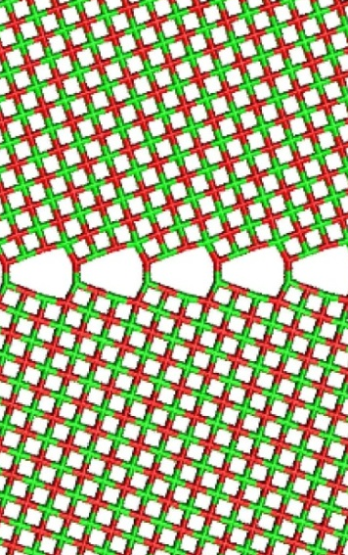
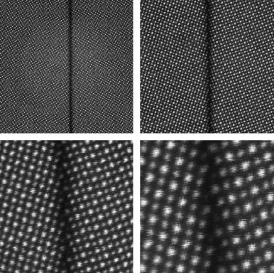
Modelling extended defects
Bicrystal approach
Consider well defined interface between two oriented crystals
Find stable atomic structure by minimising energy with respect to:
Intergrain translation and dilation
Addition/removal of ions at interface
Mimics experimental bicrystal approach often used in transmission electron microscopy
Screen structures at classical level then at DFT level
K. P. McKenna and A. L. Shluger, Nature Materials 7, 859-862 (2008)
SrTiO₃
H.-S. Lee et al., Ultramicroscopy 111, 1531 (2011)

Slide 10
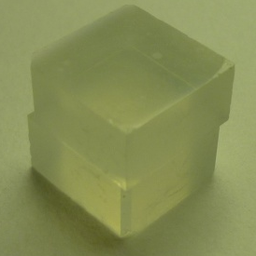
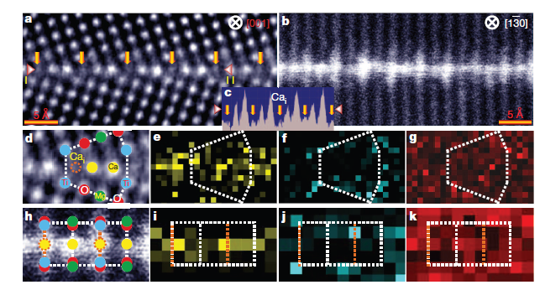
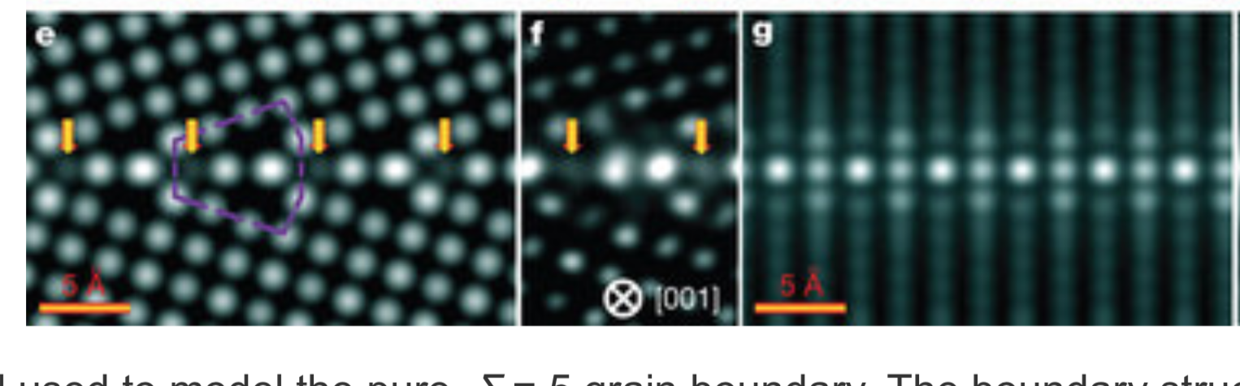
Defect induced structure transformation
(310)[001] MgO grain boundary
Experimental collaboration with Yuichi Ikuhara, Univ. of Tokyo
High purity crystals of well defined orientation thermally bonded
Transmission electron microscopy (HAADF and ABF scanning TEM and electron energy-loss spectroscopy)
DFT based simulated contrast provides excellent agreement
Ordered defect superstructure involving Ca, Ti and V_{Mg}
Ca
Ti
O
Z. Wang, M. Saito, K. P. McKenna et al, Nature 479, 380 (2011)

Slide 11
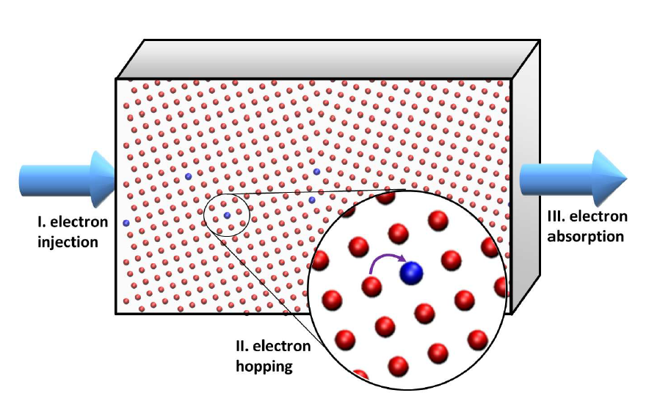
Grain Boundary Controlled Electron Mobility in TiO₂

Slide 12
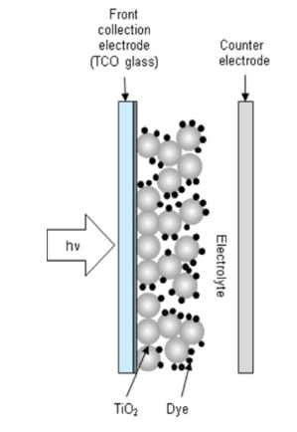
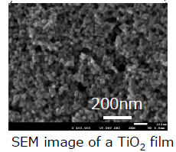
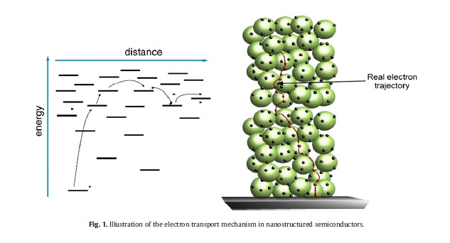
Electron diffusion in polycrystalline TiO₂
TiO₂ applications
Li-ion battery anode
Dye sensitised solar cells
Photocatalysts
Resistive switching memory
Often highly nanostructured
Many interfaces between nanocrystals (grain boundaries)
How do grain boundaries affect electron (hole) mobility?
Can they trap charge?
J. A. Anta, Curr. Opin. Coll. & Inter. Sci. 17 124 (2012)
C. Anselmi et al, Phys. Chem. Chem. Phys. 14, 15963 (2012)

Slide 13
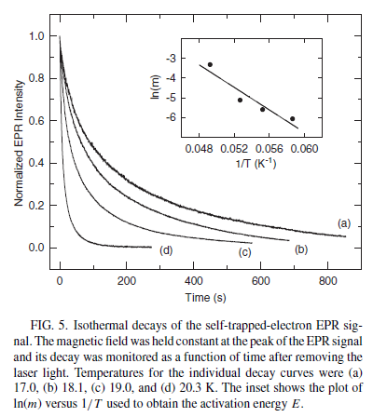
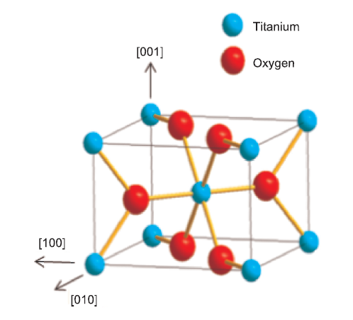
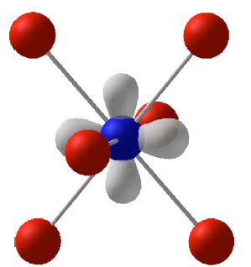
What is known?
Small e polarons in TiO₂ (rutile)
EPR studies indicates photoinduced small polaron formation (Ti³⁺)
Temperature dependence: not simple exponential decay
Fitting to general order kinetics obtain activation energy ~ 25 meV (hopping/ionisation into CB?)
S. Yang et al, Phys. Rev. B. 87,125201 (2013)

Slide 14
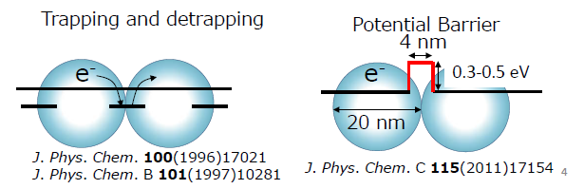
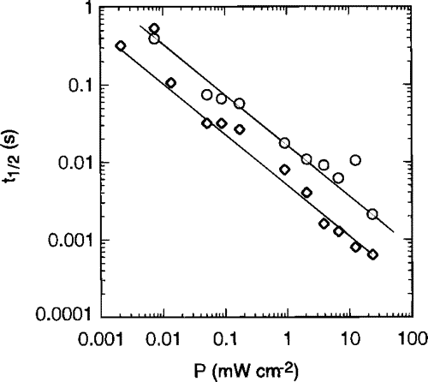
Role of interfaces
Measured photocurrent diffusion coefficients much less than expected for free electrons (e.g. 10⁻² cm²s⁻¹ for anatase)
Trap sites (bulk, surface & interface) suggested to control transport
Strong intensity (current density) dependence on e diffusion
Challenging to probe directly
Various models of role of interfaces
Photocurrent rise time (s)
Power (mW cm⁻²)
F. Cao et al, J. Phys. Chem. 100,17021 (1996)
M. Yanagida, Effect of the Charge Collection Electrode on Electron Transport in Nanocrystalline TiO₂, IWAMSN2012 (2012)

Slide 15
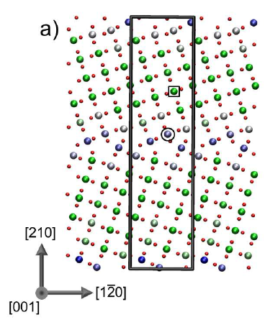
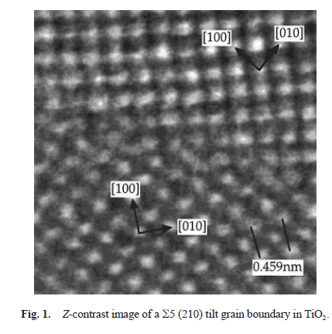
Grain boundary in rutile
Rutile (210)[001] TiO₂ grain boundary
Predicted structure in good agreement with TEM studies
Variation in ion coordination, strain and electrostatic potential near GB
Bulk-like Ti site
Perturbed GB site
Predicted structure coloured according to electrostatic potential @ Ti sites
TEM image of rutile (210)[001] TiO₂ GB
D. J. Wallis et al., J. Am. Ceram. Soc. 80, 499 (1997)

Slide 16
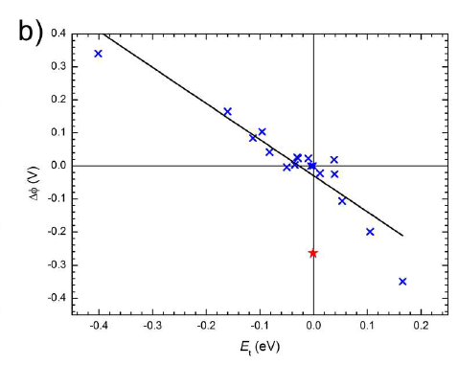
Electron polaron trapping energies in TiO₂
Electron trapping
DFT+U approach to correct self-interaction error (U_{Ti}=4.2 eV)
Total energy for electron trapped at all inequivalent Ti sites calculated
Dilate O ions by 0.08 Å around a given Ti to create precursor for localisation
Trapping energy E_{t} (eV) defined with respect to bulk Ti site
Strong correlation between trapping energy and electrostatic potential (slope = -1.1 +/- 0.1)
more stable than bulk
less stable than bulk

Slide 17
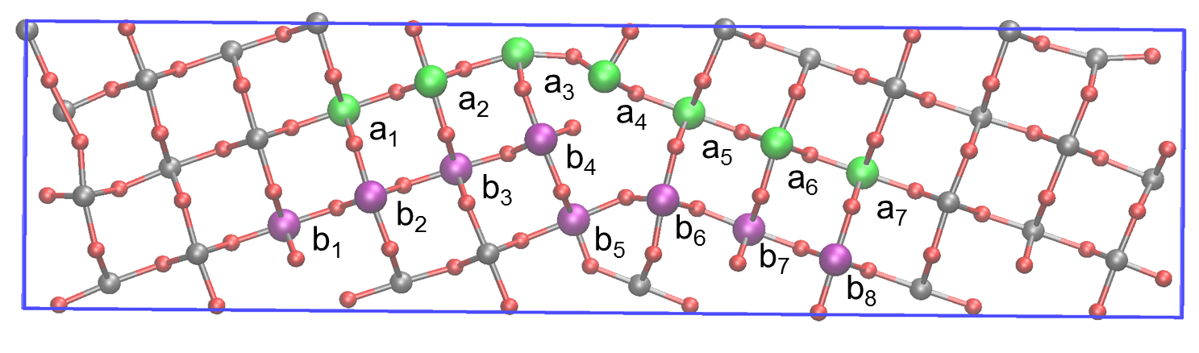
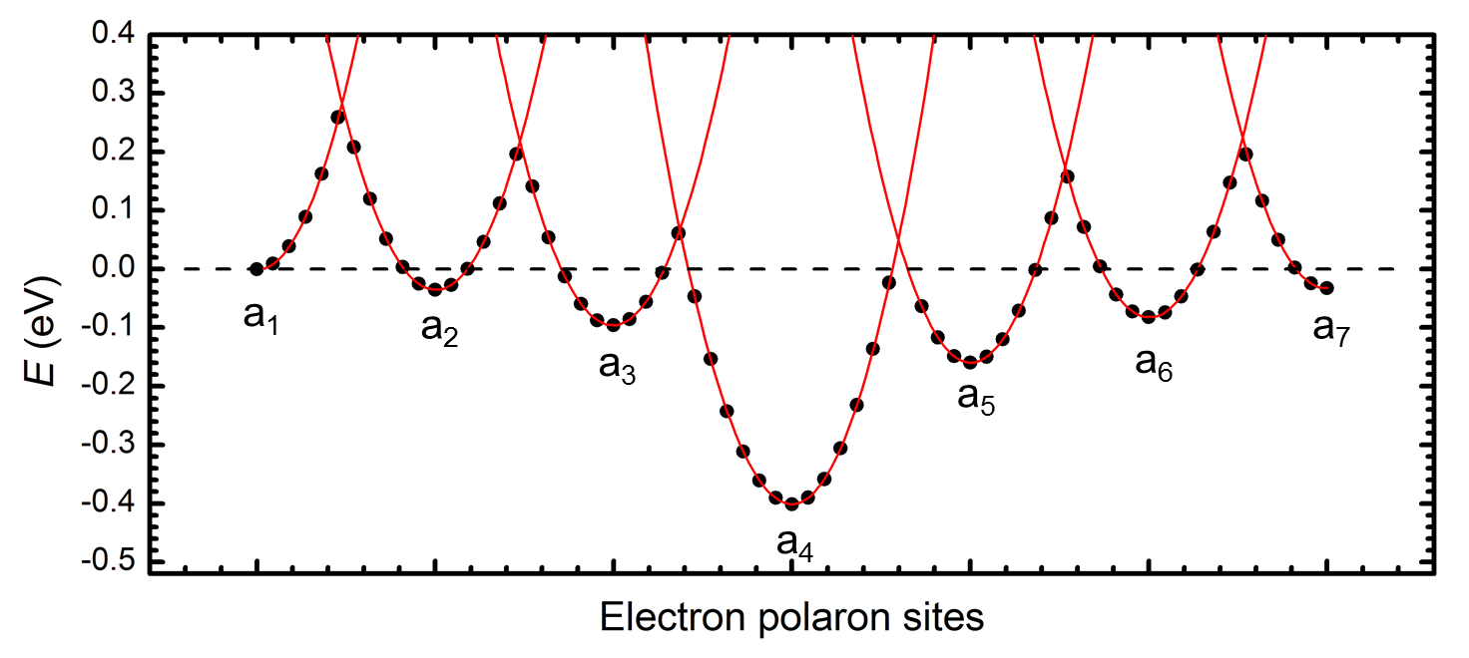
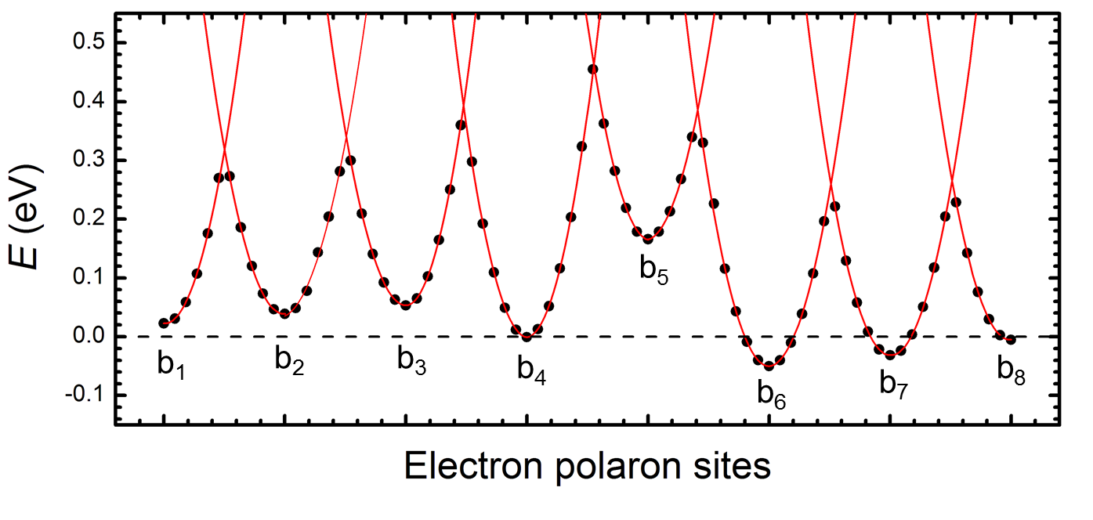
e diffusion perpendicular to grain boundary
Two possible paths in z-direction:
Path a:
Path b:
High trapping energy of site a₄ could lead to blocking of path a → low intergrain connectivity
E_{act} (bulk) ~ 0.28 eV
E_{act} (max) ~ 0.46 eV
E_{act} (bulk) ~ 0.28 eV
E_{act} (max) ~ 0.46 eV

Slide 18
Electron transport simulation
Kinetic Monte Carlo approach
Electron transfer described using Marcus/Mott/Holstein theory
Electron-electron electrostatic interactions included
Model electron injection, hopping (in all directions) and absorption
S. Wallace and K. P. McKenna, Adv. Mater. Inter. 1, 1400078 (2014)

Slide 19
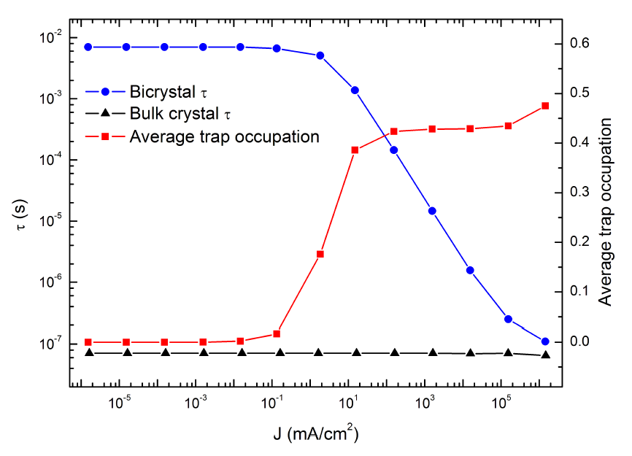
S. Wallace and K. P. McKenna, Adv. Mater. Inter. 1, 1400078 (2014)

Slide 20
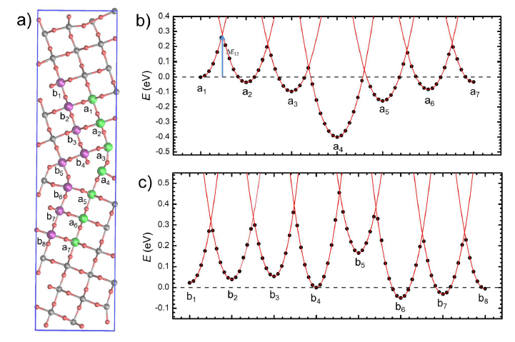
S. Wallace and K. P. McKenna, Adv. Mater. Inter. 1, 1400078 (2014)

Slide 21
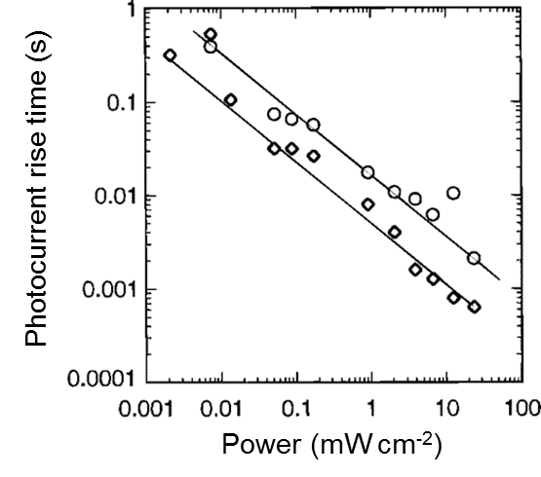
Effect of grain boundary on electron mobility
Grain boundary introduces sites with higher and lower trapping energies (+0.2 eV / -0.4 eV)
Very stable trapping sites hinder electron transport - increases e transit time many orders
Trap filling effect at higher electron currents (seen experimentally)
Can improve transport by removing interfaces, n-doping or higher photocurrents
S. Wallace and K. P. McKenna, Adv. Mater. Inter. 1, 1400078 (2014)

Slide 22
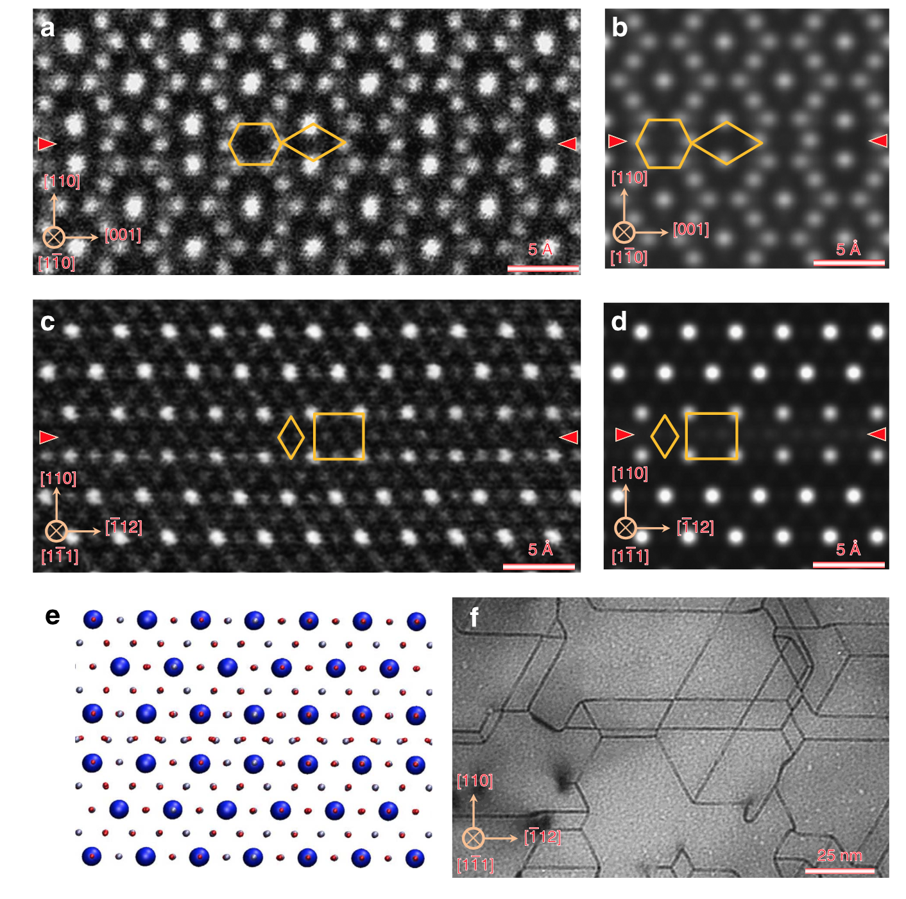
Antiphase Boundary Defects in Fe₃O₄

Slide 23
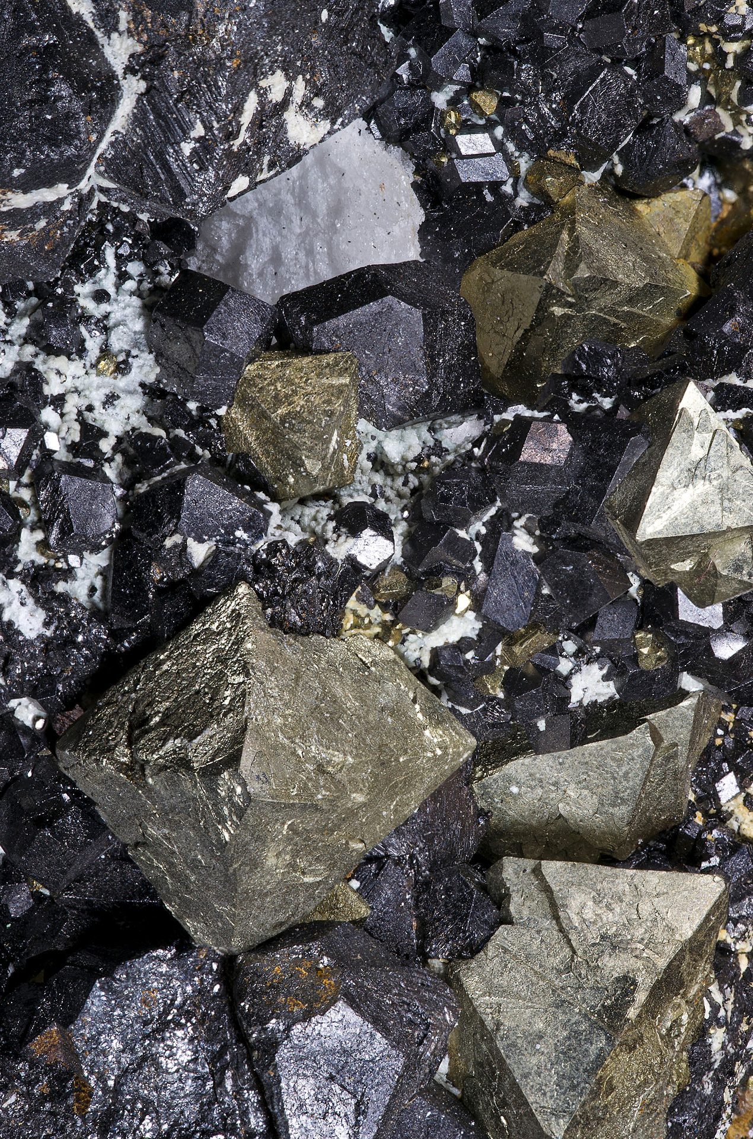
Magnetite Fe₃O₄
Abundant mineral and oldest known magnetic material
fcc oxygen lattice with interstitial Fe – tetrahedral (tet) and octahedral (oct)
tet and oct Fe sites with magnetic moments aligned antiparallel - ferrimagnetic material
Predicted to be half-metallic at room temperature
100% spin polarisation at Fermi energy attractive for spintronics applications

Slide 24
Antiphase boundary defects in Fe₃O₄
Fe₃O₄ thin films and bulk crystals have numerous APB defects
Magnetite crystals produced by annealing Fe₂O₃ have networks of APBs on {110} planes
Antiferromagnetic coupling across APBs has been proposed to explain negative magnetoresistance
But challenging to probe locally and no detailed models of atomic structure

Slide 25
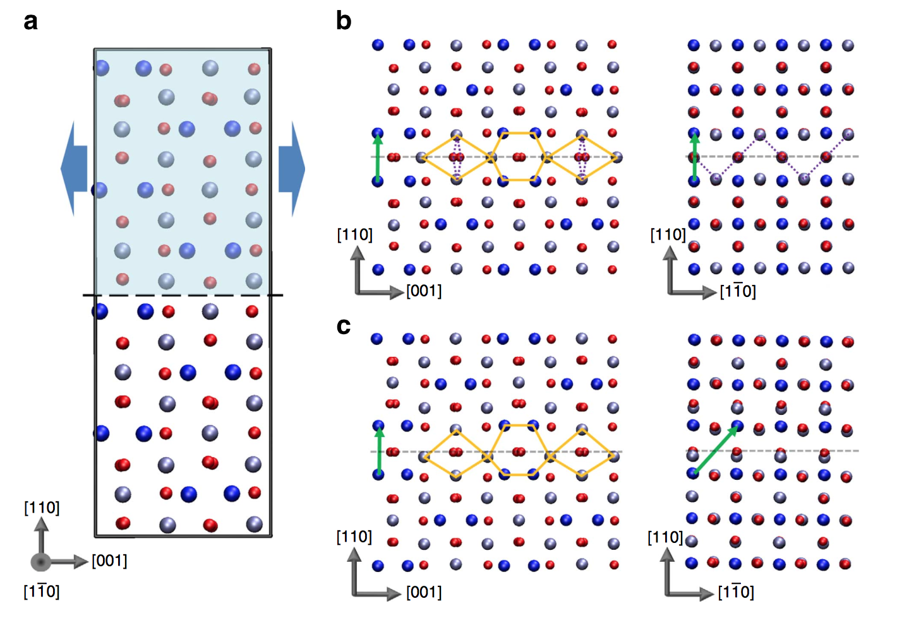
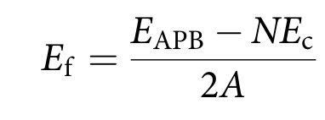
Prediction of (110) APB structure
Consider APBs forming on (110) plane
Systematic search over all possible interface structures (translations and terminations)
Screen using classical interatomic potentials then full DFT optimisation
Identify all possible APB structures with low formation energy:
K. P. McKenna, F. Hofer, D. Gilks, V. K. Lazarov, C. Chen, Z. Wang and Y. Ikuhara,
Nature Communications 5, 5740 (2014)

Slide 26
Two possible APBs found:
APB-I
crystal translation (1/4)a[110]
E_{f}= 102 mJ/m􏰂² (very low)
no net change in Fe coordination
APB-II
crystal translation (1/4)a[110]+(1/4)a[1-10]
E_{f}= 954 mJ/m􏰂²
Both APBs involve diamond and hexagonal structural units
Both APBs AF coupled (due to Fe-O-Fe bonds close to 180 degrees)
APB-I
APB-II
K. P. McKenna, F. Hofer, D. Gilks, V. K. Lazarov, C. Chen, Z. Wang and Y. Ikuhara,
Nature Communications 5, 5740 (2014)

Slide 27
Transmission electron microscopy
HAADF-STEM imaging of (110) APBs in Fe₃O₄ with atomic resolution
Images taken along the [1-10] and [1-11] directions􏰁
Compared to simulated TEM images using DFT structures
Clearly resolve hexagon diamond structural units
No asymmetry suggesting APB-I model
K. P. McKenna, F. Hofer, D. Gilks, V. K. Lazarov, C. Chen, Z. Wang and Y. Ikuhara,
Nature Communications 5, 5740 (2014)

Slide 28
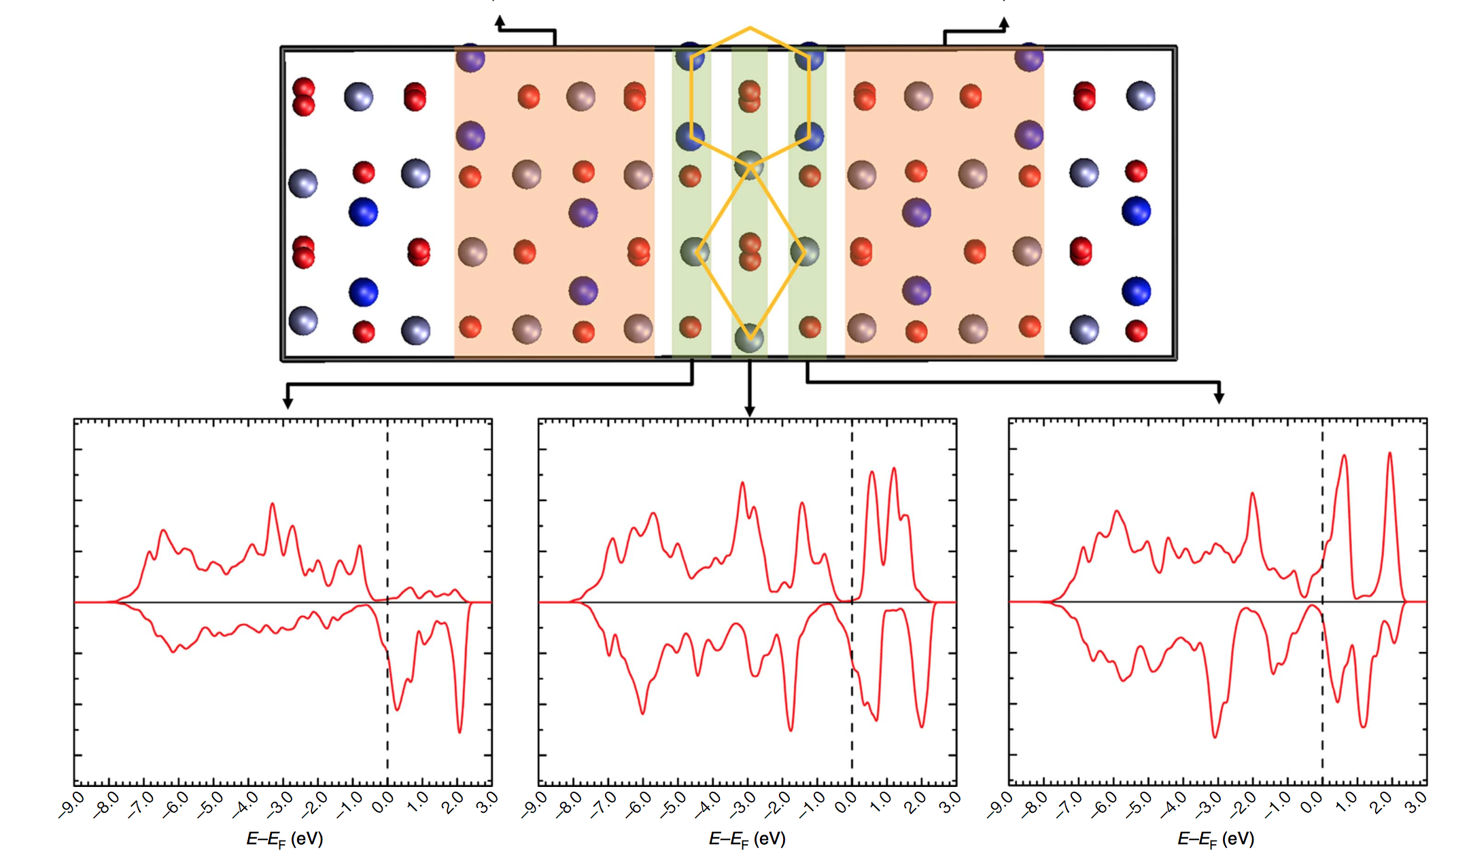
Electronic properties of APB (AF ground state)
Away from APB bulk electronic structure recovered rapidly
Spin polarization reverses direction across the APB plane, hence the transport of electrons between the domains in both spin states will be associated with substantial scattering

Slide 29
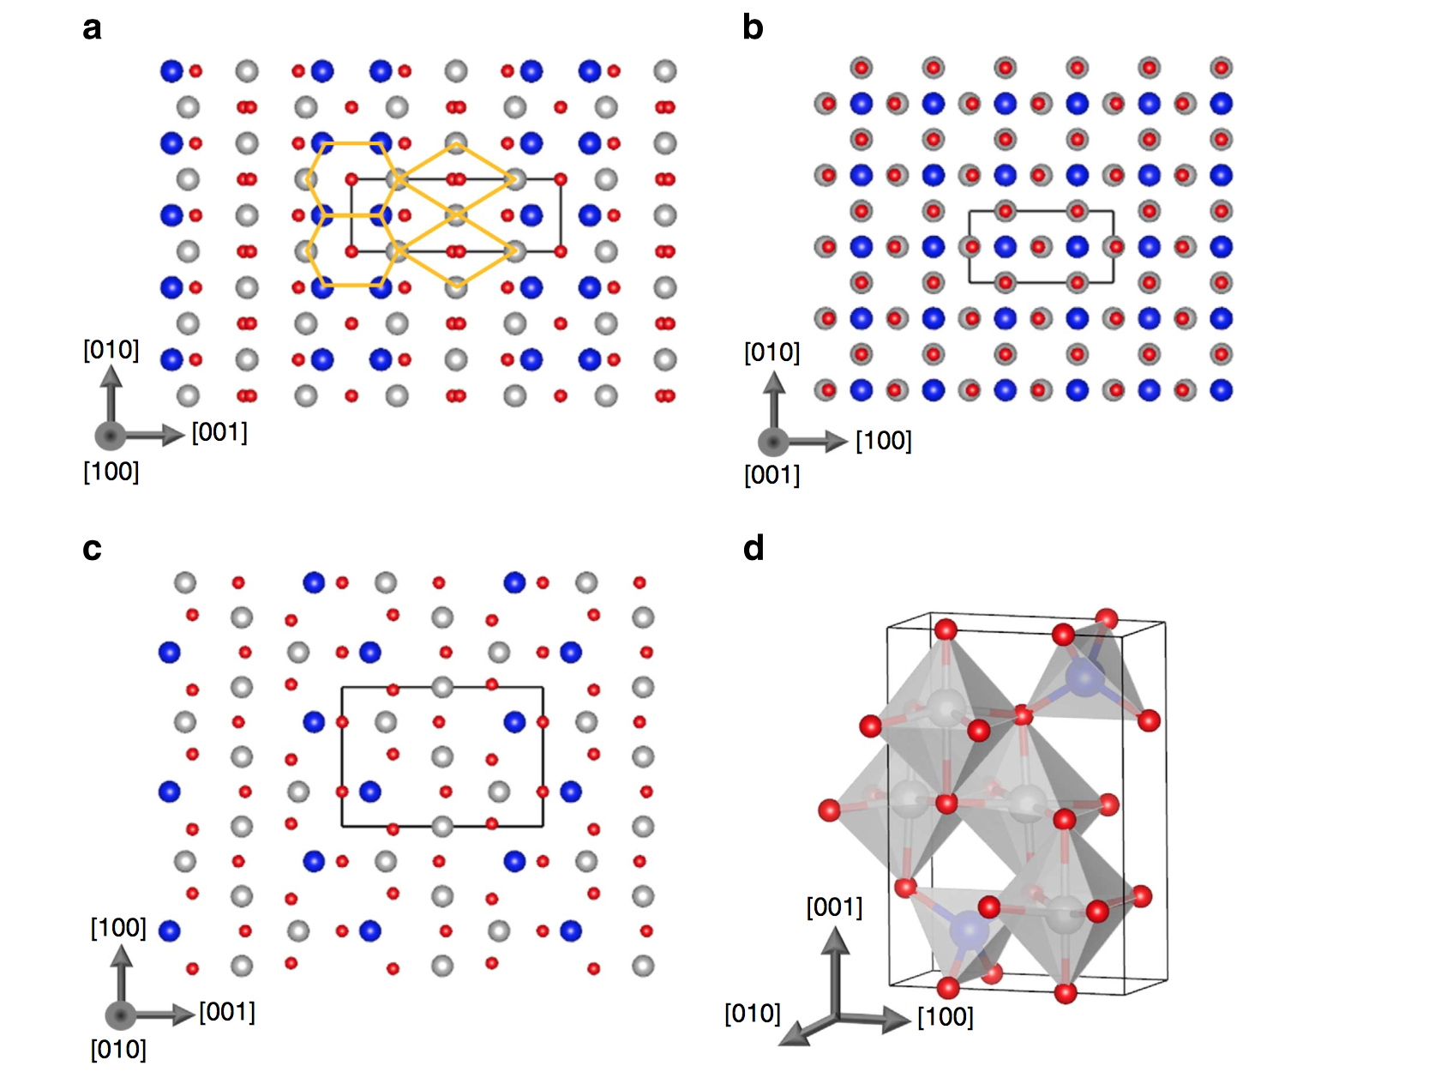
Explanation of high stability of (110) APB
Diamond and hexagonal structural units are highly stable (not seen in cubic Fe₃O₄)
Are they stable as a bulk phase? ➔ Pmma phase
DFT calculation indicates Pmma Fe₃O₄ is only 332 meV per formula unit less stable than the cubic
Pmma phase is also ferrimagnetic and could be stablised by strain in nanostructures
K. P. McKenna, F. Hofer, D. Gilks, V. K. Lazarov, C. Chen, Z. Wang and Y. Ikuhara,
Nature Communications 5, 5740 (2014)

Slide 30
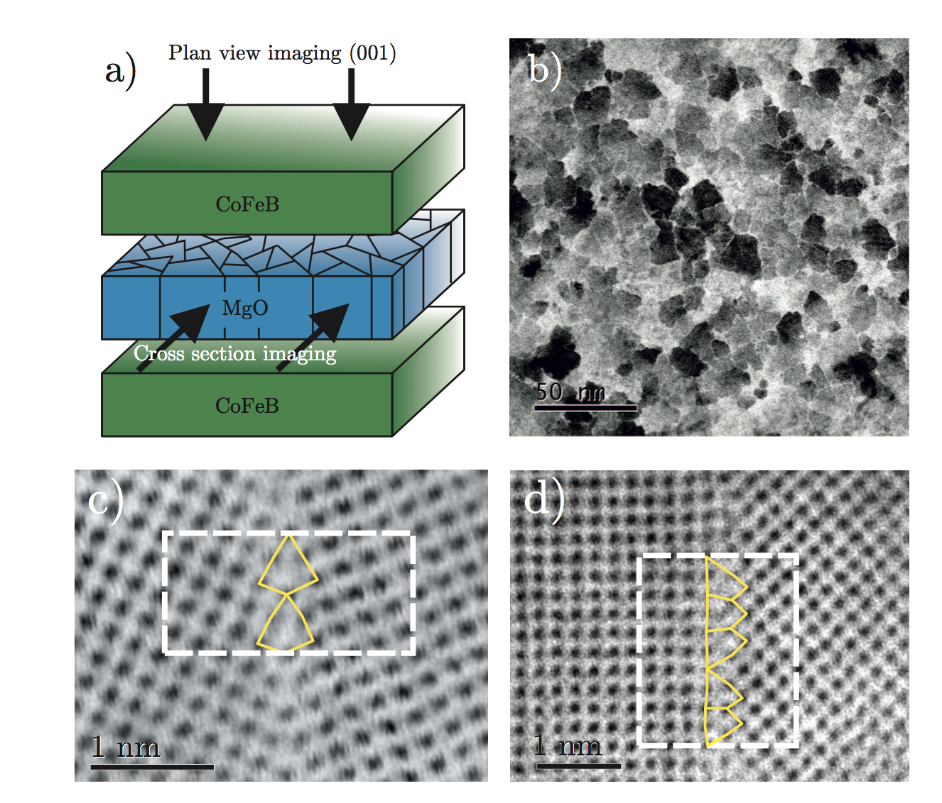
Grain Boundaries in Magnetoresistive Tunnel Junctions

Slide 31
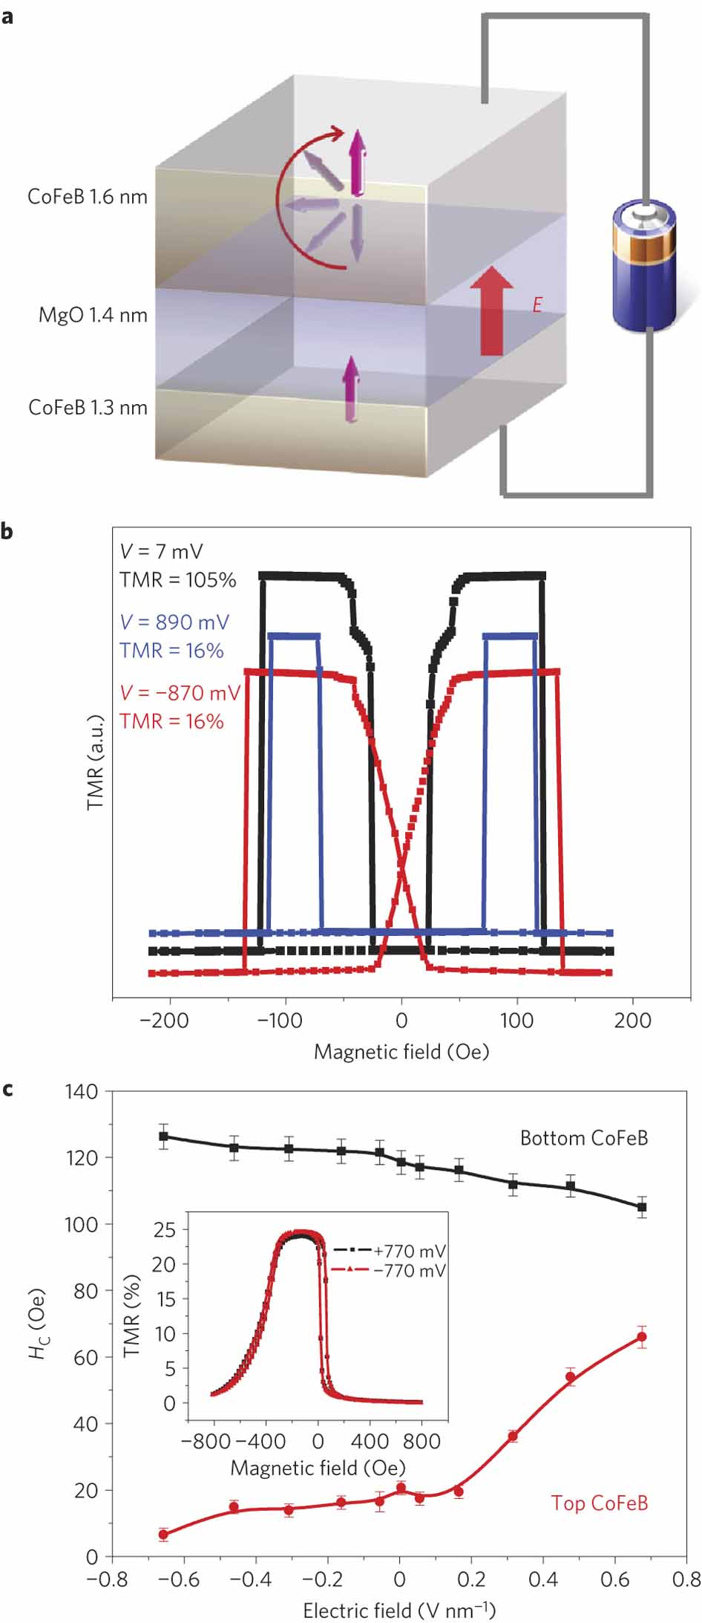
Magnetoresistive tunnel junctions
CoFeB/MgO tunnel junctions
Large change in resistance on application of magnetic field
Due to spin-dependent tunnelling through thin MgO barrier
Applications in hard disk read heads and STT-RAM
MgO barrier is usually polycrystalline
Effect on electronic properties?
Z. Wang, M. Saito, K. P. McKenna, S. Fukami, H. Sato, S. Ikeda, H. Ohno and Y. Ikuhara
Nano Letters 16, 1530 (2016)

Slide 32
MTJs from Hideo Ohno’s group, Tohoku University, Japan (TMR> 600%):

Slide 33
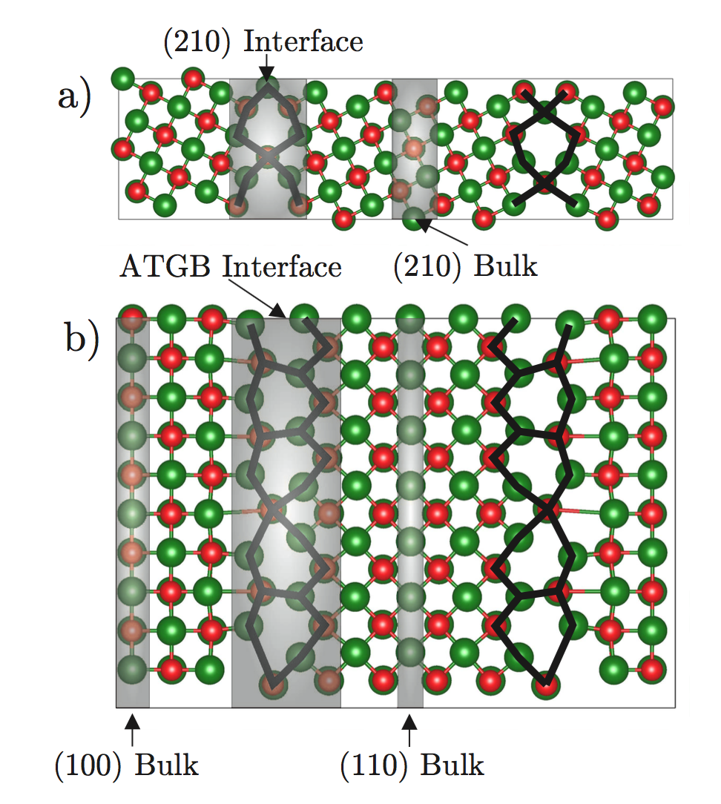

J. Bean et al, Sci. Rep. 7, 45594 (2017)

Slide 34


J. Bean et al, Sci. Rep. 7, 45594 (2017)

Slide 35


J. Bean et al, Sci. Rep. 7, 45594 (2017)

Slide 36
Conclusions
[001] tilt grain boundaries present in MgO layer of MTJ
Local band gap reduced significantly at GBs (by up to 3 eV)
Predict shunting of current through GBs and associated reduction of TMR
GBs must be passivated to achieve highest TMR

Slide 37
Summary
DFT investigation of defects
Oxides find diverse applications where defects control performance
Defects possess complex electronic, magnetic, optical and chemical properties
Often challenging to probe by experiment alone
Examples presented show how materials modelling can complement experiment and help understand defect properties and functionality

Slide 38






Surfaces
Intrinsic defects
Impurities
Polarons
Grain boundaries
Dislocations

Slide 39



Acknowledgements
People:
J. Bean, F. Hofer (Physics, York)
D. Gilks & V. K. Lazarov (Physics, York)
C. Chen, M. Saito & Y. Ikuhara (WPI-AIMR, Tohoku University & The University of Tokyo)
S. Fukami, H. Sato, S. Ikeda, H. Ohno (RIEC, Tohoku University)
Funding:
EPSRC Fellowship (EP/K003151)
EPSRC grants (EP/K03278X and EP/K013114)
Nuffield Foundation and Institute of Physics
COST Action CM1104
Computational time:
UK Materials Chemistry Consortium (EPSRC grants EP/F067496 & EP/L000202)

Slide 42

Interdiffusion in Magnetoresistive Tunnel Junctions

Slide 43
Magnetoresistive tunnel junctions
CoFeB/MgO tunnel junctions
Large change in resistance on application of magnetic field
Due to spin-dependent tunnelling through thin MgO barrier
Applications in hard disk read heads and STT-RAM
Interaction of Co, Fe and B with MgO – is there any interdiffusion?
Effect on electronic properties?
Z. Wang, M. Saito, K. P. McKenna, S. Fukami, H. Sato, S. Ikeda, H. Ohno and Y. Ikuhara
Nano Letters 16, 1530 (2016)

Slide 44
DFT investigation of defects in MgO
DFT PAW (VASP), PBE functional
E_{cut}=400 eV, k=9x9x9
Consider B, Co and Fe incorporation into interstitial, anion and cation sites of MgO and also Ta
Consider incorporation of ions in all possible charge states
Formation energies calculated:
Co₂₀Fe₆₀B₂₀ used to define B, Fe and Co chemical potential
Chemical potential – determined by electrode and O partial pressure
Fermi energy – determined by electrode band offset/applied voltage

Slide 45

B defect formation energies
B most favourable in fcc Ta interstitial site
If oxygen poor then B incorporation in MgO difficult
If oxygen rich can incorporate as 3+ or 1+ ion in cation site
Z. Wang, M. Saito, K. P. McKenna, S. Fukami, H. Sato, S. Ikeda, H. Ohno and Y. Ikuhara
Nano Letters 16, 1530 (2016)

Slide 46

EELS mapping
As grown
Annealed
Boron diffuses into Ta. No evidence for B in MgO.
Z. Wang, M. Saito, K. P. McKenna, S. Fukami, H. Sato, S. Ikeda, H. Ohno and Y. Ikuhara
Nano Letters 16, 1530 (2016)

Slide 49
Additional slides

Slide 50

A complex problem
Interfaces between anatase & rutile nanocrystals
Role of surfaces as trapping sites (including steps, corners, etc)
Role of dye molecules
Role of electrolyte
Hydroxyls, impurities and intrinsic defects
Mechanisms of e transport
Recombination effects
B. Buesser, A.J. Gröhn and S.E. Pratsinis, Sintering Rate and Mechanism of TiO₂ Nanoparticles by Molecular Dynamics, AIChE Proceedings (2011)

Slide 51

Modelling electron trapping
Density functional theory
VASP code: plane wave basis and PAW method
PBE functional
E_{cut}=500 eV, k=6x6x9 for rutile conventional cell
Force tolerance 0.01 eV/Å
Rutile TiO₂ lattice constant within 2% of experiment (a=4.67 Å, c=3.03 Å)
DFT+U correct self-interaction error for trapped electron
Here use U_{Ti}=4.2 eV (fitted to spectroscopic properties of oxygen vacancies)
Rutile TiO₂
Electron polaron trapped on Ti ion
D. Muñoz Ramo, et al, Phys. Rev. Lett. 99, 155504 (2007)
N. A. Deskins and M. Dupuis, Phys. Rev. B 75, 195212 (2007)
B. J. Morgan and G. W. Watson, Surf. Sci. 601 5034 (2007)

Slide 52
Electron polaron trapping energies in TiO₂
Electron trapping
Total energy for electron trapped at all inequivalent Ti sites calculated
Dilate O ions by 0.08 Å around a given Ti to create precursor for localisation
Trapping energy E_{t} (eV) defined with respect to bulk Ti site
Strong correlation between trapping energy and electrostatic potential (slope = -1.1 +/- 0.1)
more stable than bulk
less stable than bulk

Slide 53


Parallel to grain boundary (y-direction)
Bulk diffusion in (001) direction E_{act}=0.23 eV (i.e. electrons less mobile along dislocation line)
E_{act}=0.28 eV
a₁
a₁
a₁
a₁

Slide 54


Parallel to grain boundary (x-direction)
E_{act}(max)=0.58 eV

Slide 55

Modelling electron transfer
Marcus theory
Consider charge transfer between 2 species in a polarisable medium (e.g. He in water)
Two isoenergetic equilibrium configurations
Identify collective coordinate for polarisation of medium, Q
He⁺
He⁰
Electron transfer rate is given by

Slide 56


Electron hopping rate
Adiabatic electron transfer with rate:
Activation energies from DFT calculations (Marcus-like model):
Parameters: κ_{el} = 1, ν = 24 THz, E_{act} (bulk)= 0.3 eV, H_{ab} = 0.2 eV, k_{B}T = 0.026 eV
Qualitative trends not affected by parameters but absolute currents are
N. A Deskins and M. Dupuis, Phys. Rev. B 75, 195212 (2007)

Slide 57


Electron-electron interactions
Consider interaction between two electrons in bulk

Slide 58


Calculation of H_{ab} and λ
Multi-reference wavefunction methods
H_{ab} accurate but computationally expensive
Convergence with respect to atomic basis set
Limited to small molecular systems
λ requires forces (prohibitively expensive)
Density functional theory
Large systems (>300 atoms) and forces
Self-interaction error
poor description of charge localised states
even for hybrid functionals with non-local exchange
Finite size effects (H_{ab} and λ) for periodic boundary conditions
Hole transfer in C₂H₄-(CH₂O)_{n}-C₂H₄
F. Plasser and H. Lischka, J. Chem. Phys. 134, 034309 (2011)
TiN/HfO₂/TiN tunnel junction
Notes:
Ethylene-formaldehyde-Ethylene

Slide 59


Constrained density functional theory
Constraint to enforce localisation of electron on donor or acceptor
Construct Hamiltonian in this diabatic (charge localised basis) → H_{ab} given by off-diagonal elements
initial state
D----------A
final state
D----------A
Good agreement with multi-reference methods for molecular systems
Implemented in CPMD code
periodic plane wave basis
Troullier-Martins or Goedecker-Hutter pseudopotentials
GGA and hybrid functionals
Electron transfer in (He-He)⁺
Q. Wu and T. van Voorhis, Phys. Rev. A 72, 024502 (2005)
H Oberhofer, JB, J. Chem. Phys. 133, 244105 (2010)

Slide 60


Marcus theory
Initial
Final
TS
Landau-Zener theory
(H_{ab})
Transition state theory
(H_{ab}, λ)

Slide 61
Cancelation of nonlinearity (CON) method
Predicting polaron formation
Often parameters (U or HF%) fitted to experimental properties (e.g. band gap)
Does not guarantee self-interaction is eliminated therefore cannot predict polaron formation
An exact functional should satisfy Janak’s theorm:
Linear dependence of energy on fractional occupation
LDA/GGA is convex (delocalised), HF is concave (overlocalises)
An exact functional should satisfy the DFT-Koopmans’ condition
E
Exact
DFT
HF
N-1
N
N+1
CB
add electron (E_{+/0})
e_{i}
M. Cococcioni & S. de Gironcoli, Phys. Rev. B 71, 035105 (2005)
S. Lany and A. Zunger, Phys. Rev. B 80, 085202 (2009)
VB

Slide 62

Hole trapping in m-HfO₂/ZrO₂
Perfect lattice properties
Calculation details
VASP, PBE, 400 eV, k=8³
Crystal structure within 1% of experiment
m-HfO₂ and m-ZrO₂ very similar (focus on hafnia in the following)
Monoclinic structure
7C cations
3/4C anions arranged into 2D layers
Electrostatic (Madelung) potential
potential is 0.36 V higher on 3C oxygen ions than 4C oxygen ions
4C
3C
4C
3C
4C
[001]
[100]
K. McKenna et al, Phys. Rev. Lett. 108, 116404 (2012)

Slide 63


Electronic properties
Projected DOS shows top of valence band has O_{3C} character
splitting between 3C and 4C correlates with electrostatic potential
Hole introduced vertically is delocalised over 2D 3C-O planes
Dispersion in [100] is small
Therefore, for holes m-HfO₂ is a layered 2D material
If a polaron forms, does it only form in the 3C-O plane?
4C
3C
4C
3C
4C

Slide 64



Self-consistent determination of the hole potential
e_{i}
All polaron calculations use 324 atom unit cell and energies corrected for finite-size effects (image-charge and potential alignment )
E_{+/0}
e_{i}
E – E_{VBM} (eV)
E_{+/0}
3C O
λ_{hs}=3.8 eV
4C O
λ_{hs}

Slide 65
Properties of polarons in m-HfO₂
Spin density > 70% localised on oxygen (O⁻)
Charge transition level lower on 4C O by ~ 0.3 eV (electrostatic potential difference)
Trapping energy (stability relative to delocalized hole in valence band)
E_{t} (3C) = 0.18 eV
E_{t} (4C) = -0.31 eV [metastable]
Therefore, hole polarons in HfO₂ are confined within 2D layers

Slide 66


Why is the 4C O ion less stable?
Four terms: kinetic energy, polarisation, strain, electrostatic potential
Kinetic energy and polarisation terms similar for both 4C and 3C
Difference is due to strain (E_{s}) and electrostatic potential

Slide 67


Barrier to hole self-trapping
20 meV fluctuation sufficient for 2D localisation
40 meV barrier to self-trapping
[100]
[001]
[010]
[001]

Slide 68


Polaron mobility
Highly anisotropic activation energy
within 3C planes 0.14 eV
perpendicular to 3C planes > 0.60 eV
Hopping mechanism
thermal trapping energy (0.18 eV) is comparable to activation energy
ionisation/re-trapping (Frenkel-Poole emission) seems to be the relevant transport mechanism
Experimental high temperature conductivity measurements
p-type (hole ionisation form cation vacancies)
activation energy 0.2 eV
[001]
[100]
N. M. Tallan, W. C. Tripp, and R.W. Vest, J. Am. Ceram. Soc. 50, 279 (1967)

